Slide 1
TABLEAU PROJECT
Identifying Potential Startup for Investment
Tableau public link: https://public.tableau.com/profile/hemanth.kumar.ponnambalam#!/

Slide 2
Brief Introduction
The Project is about Identifying potentially interesting and promising startup to Invest for Venture Capital Fund
The criterion for selecting investments for this fund is a combination of :
High Revenue
Low Expense
Top Growth

Slide 3
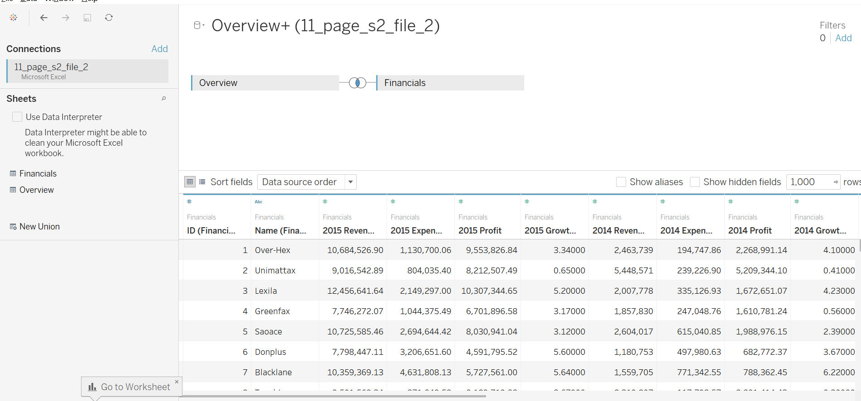
Joining Overview and Financial of Startup

Slide 4
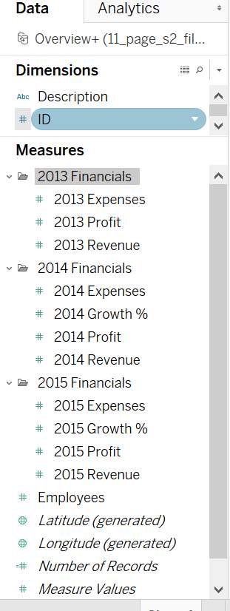
Created Folder for each financial year and grouped into that

Slide 5
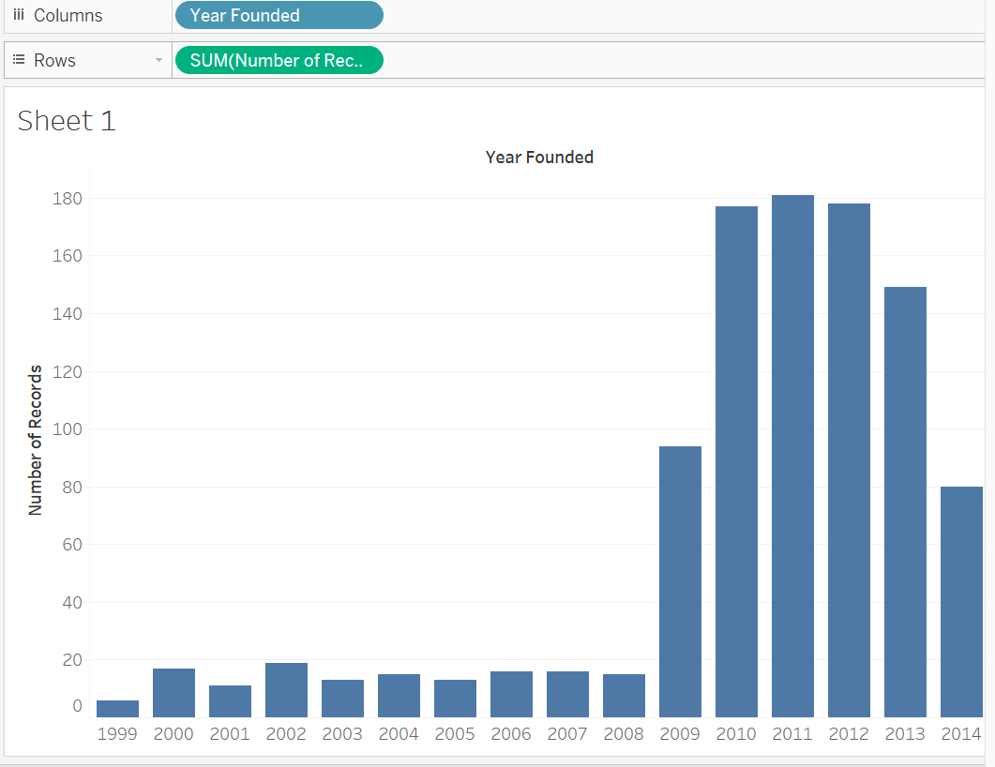
Number of Companies vs Years founded

Slide 6
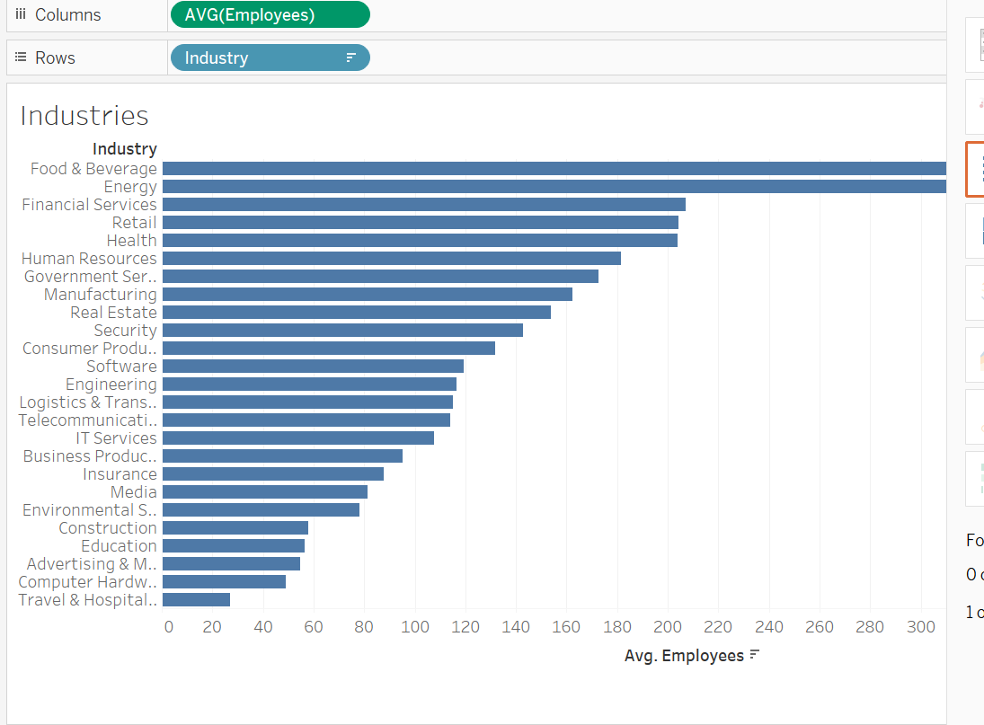
Average No of employees in each Industry

Slide 7
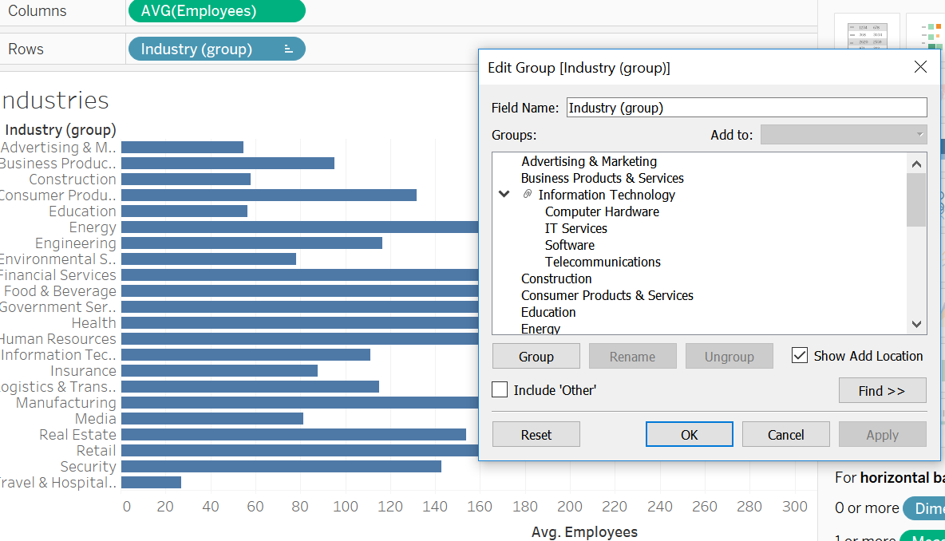
Grouped Computer related profession to one category

Slide 8
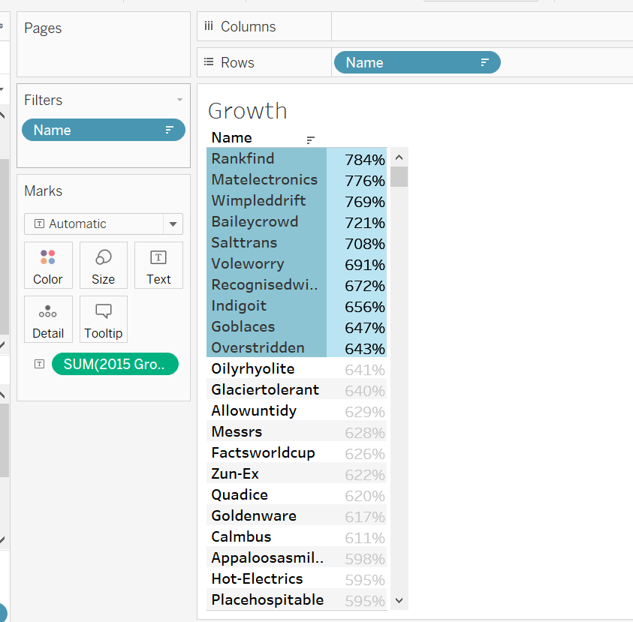
Created Set to Identify Top 10 Companies by Growth

Slide 9
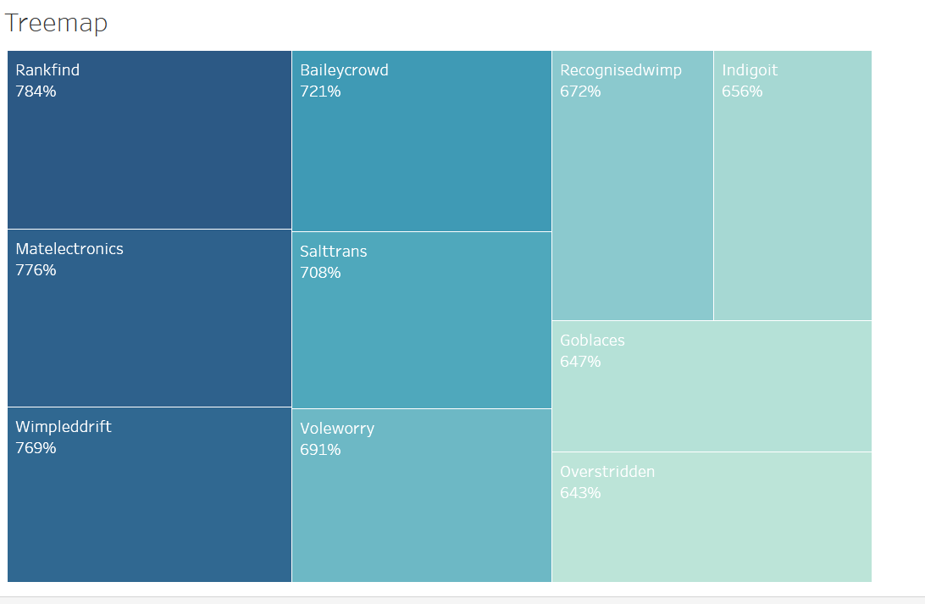
Tree Map

Slide 10
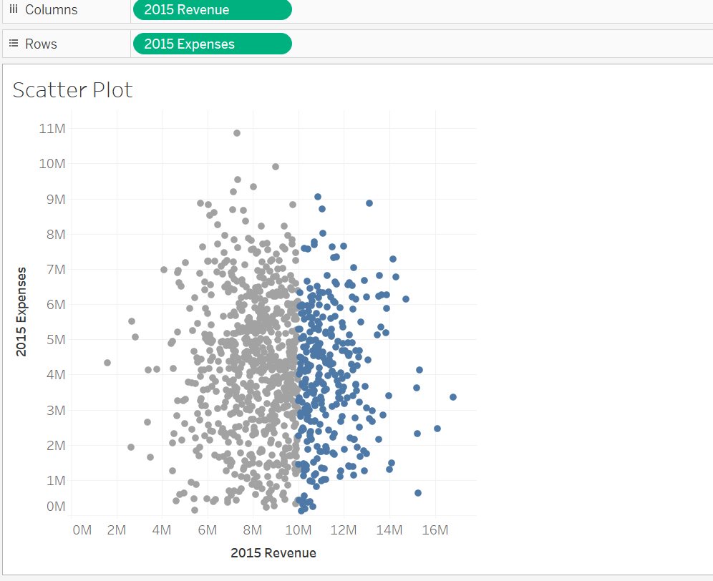
Created Scatter Plot for Identifying Revenue>10Million
Notes:
Note: To remove the aggregate
Analysis – uncheck aggregate measures to get the scatter plot for all observations

Slide 11
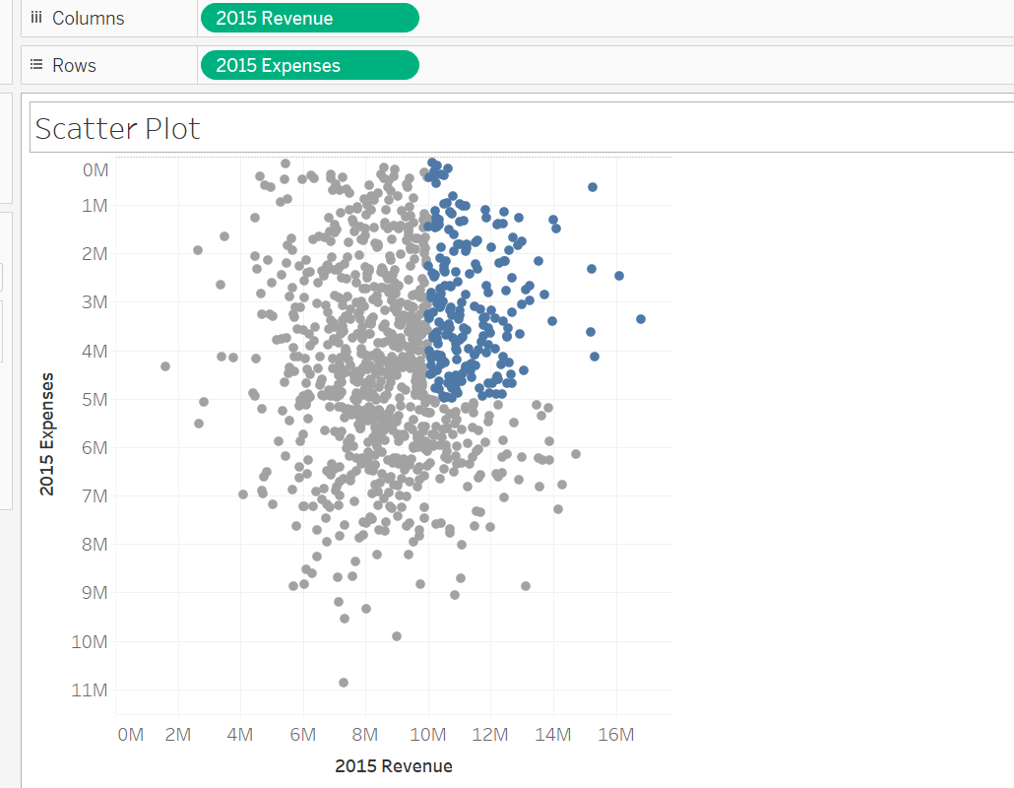
Combined Set to Identify High Revenue and Low Expense
Notes:
Note: Click any set to combine and choose combine set and choose the necessary set operator to get the desired O/P
We can reverse the axis by editing the Y axis – Reverse option

Slide 12
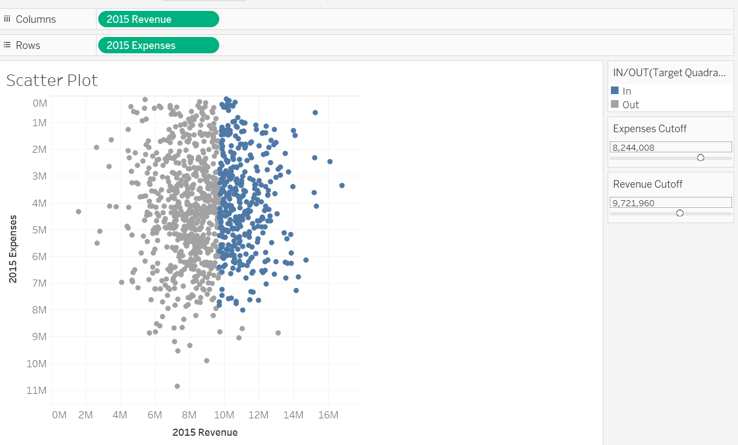
Created Parameter Control to allow the user to change the O/P results
Notes:
Right Click on empty space to create the parameters

Slide 13
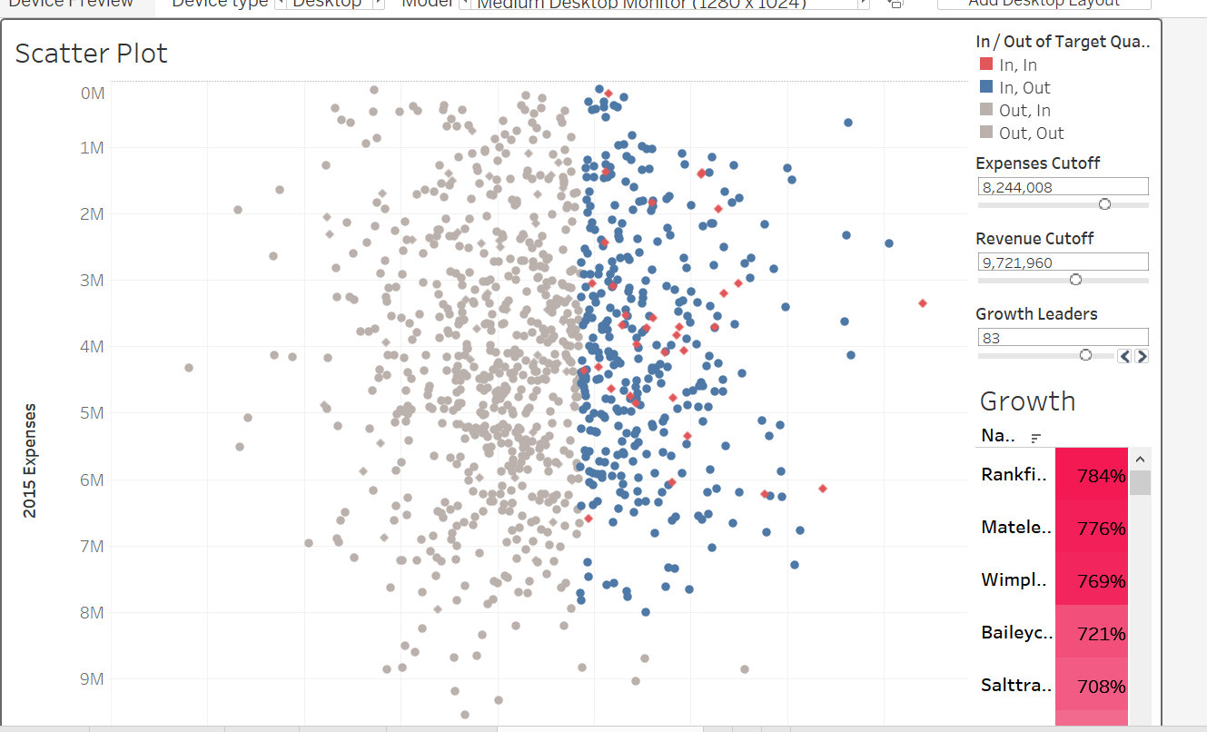
Created Dashboard for Venture Capital Funds

Slide 14
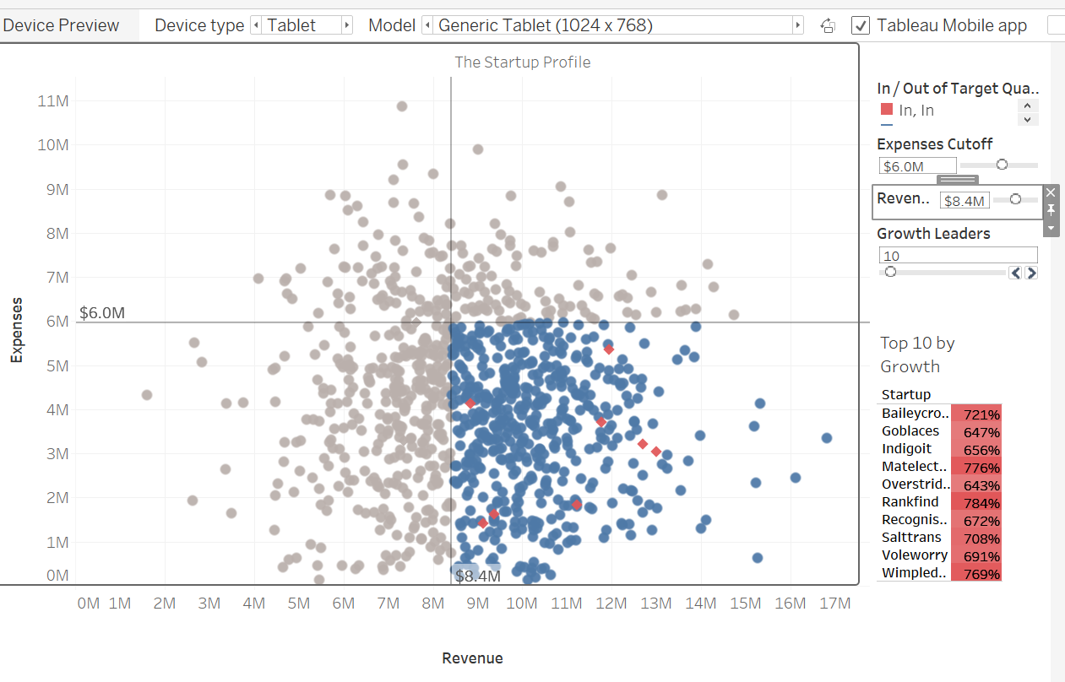
Top 10 Companies by Growth

